Slide 1
Networking
Number System

Slide 2
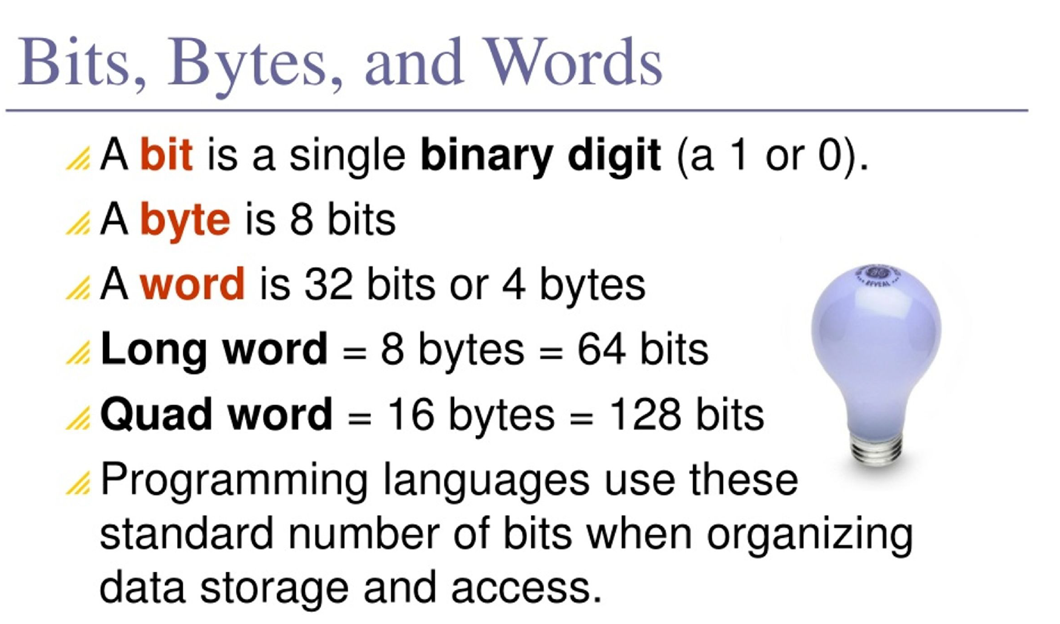

Slide 3
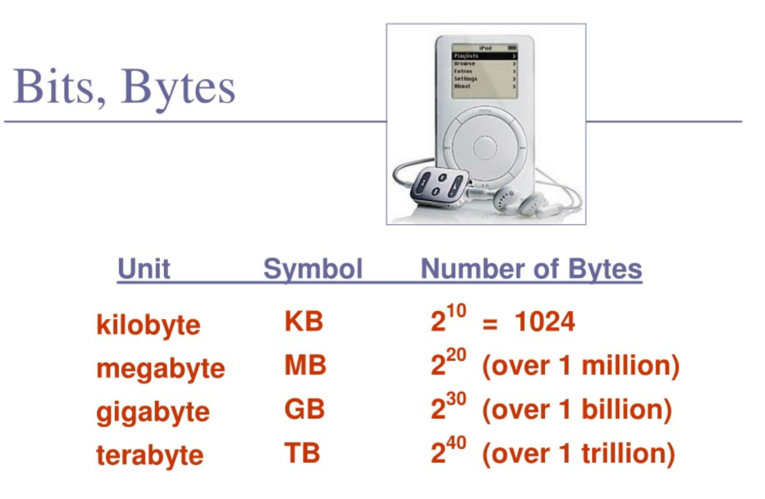

Slide 4
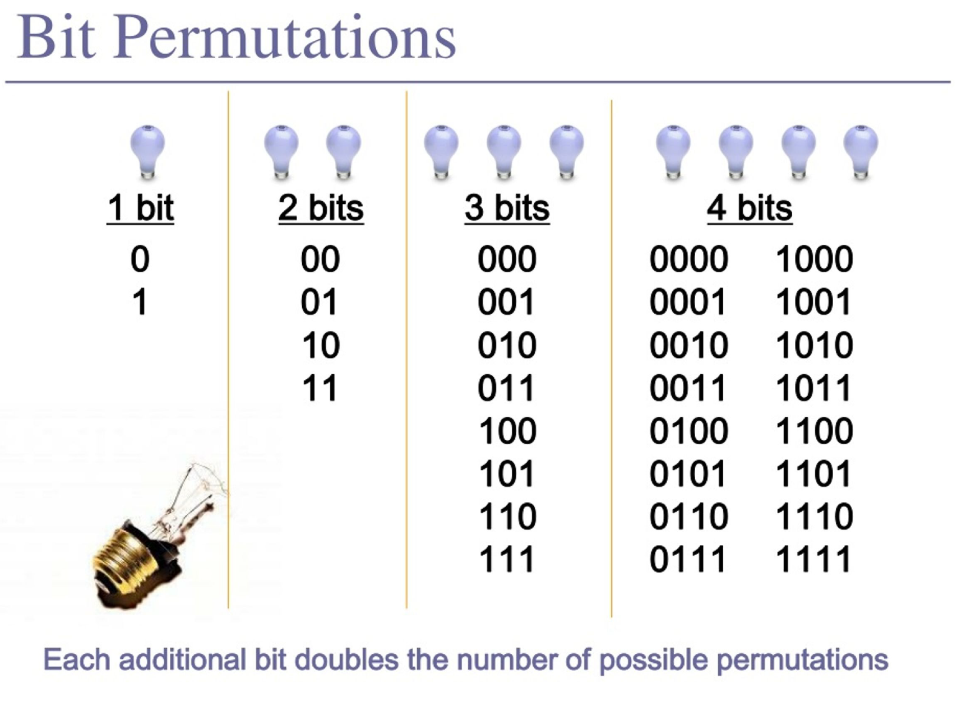

Slide 5
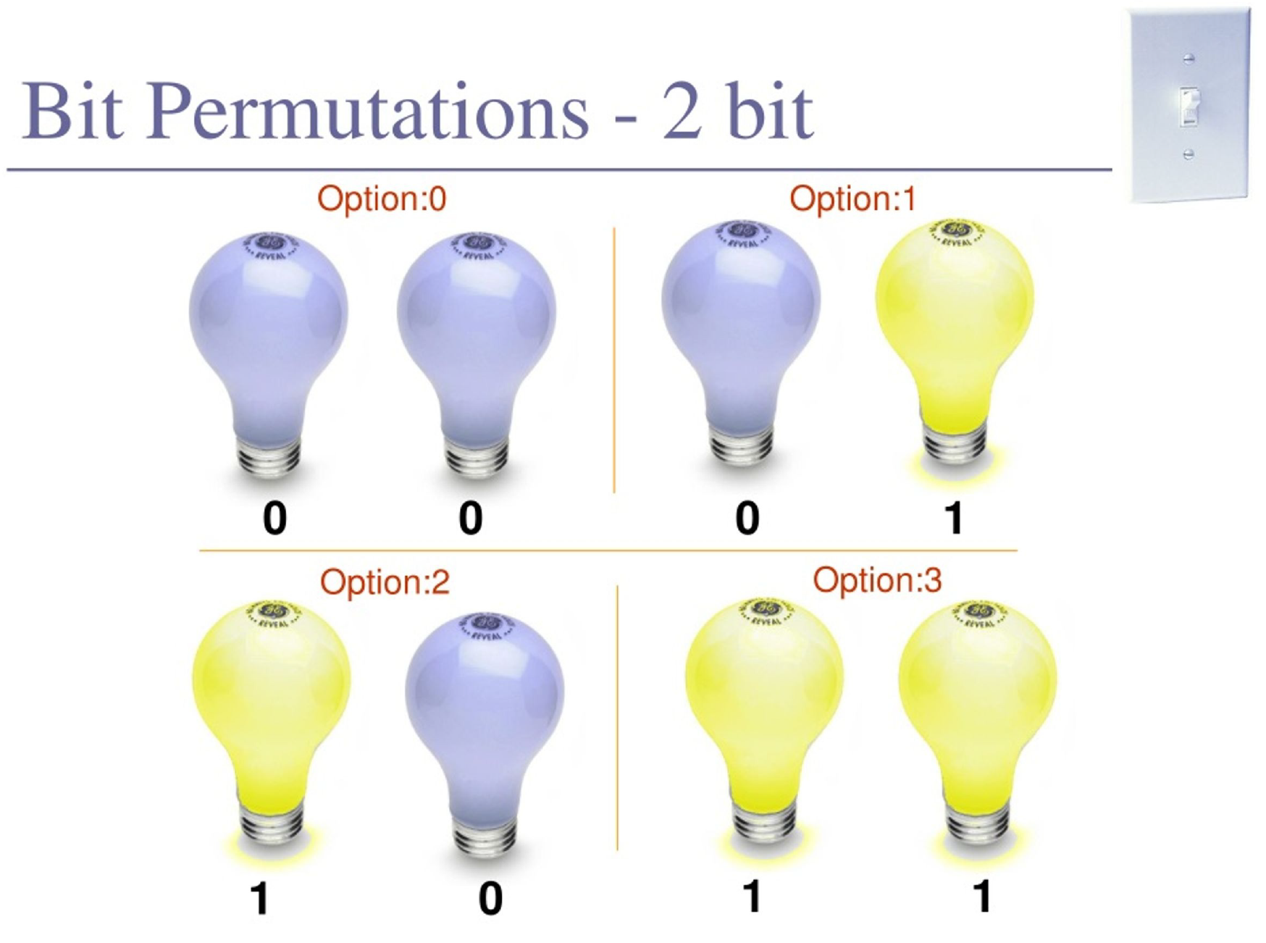

Slide 6
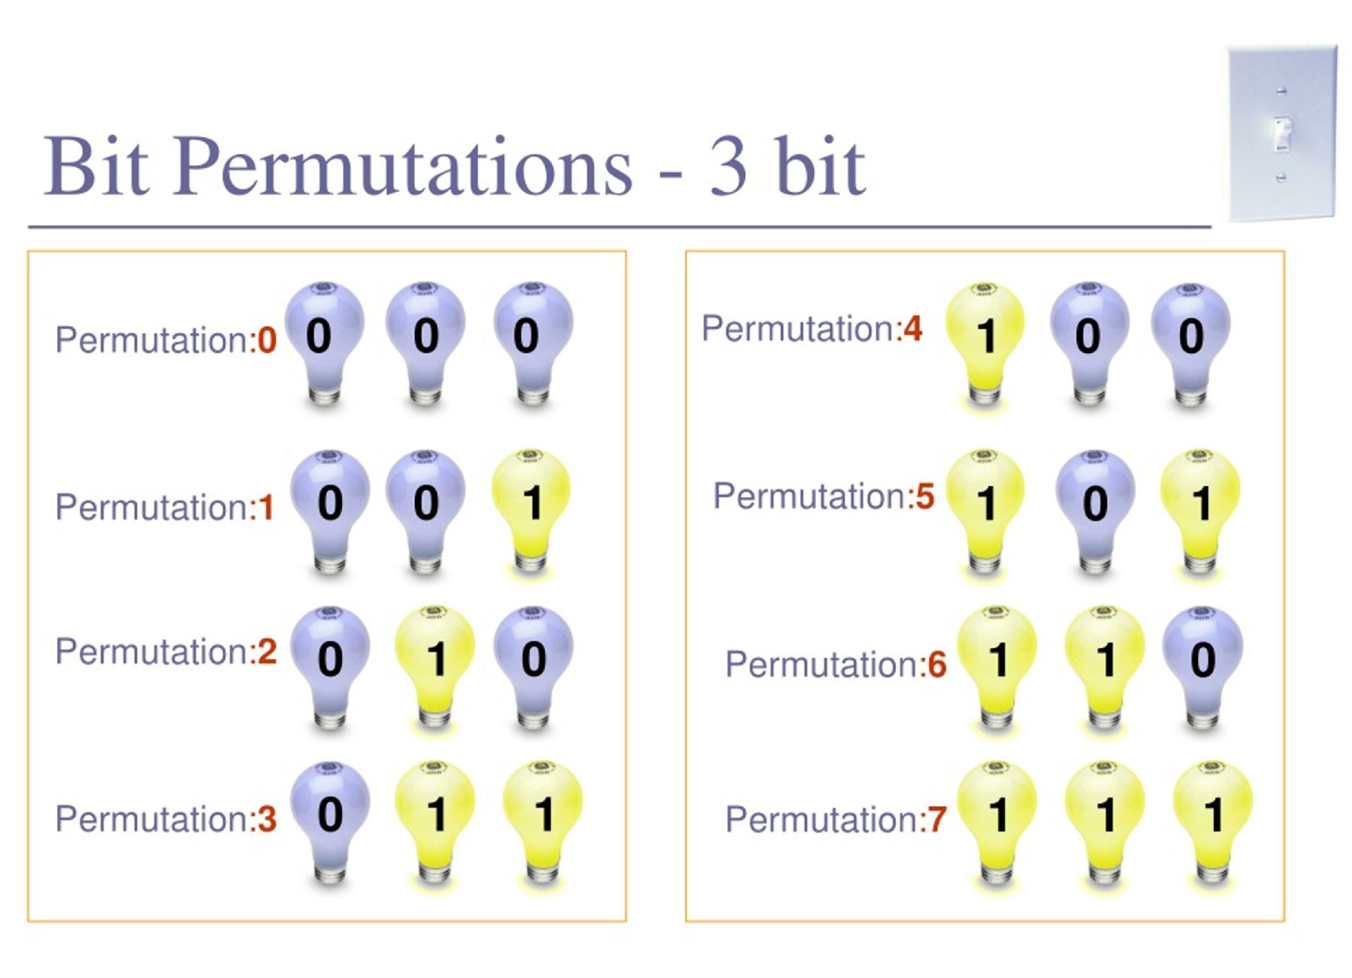

Slide 7
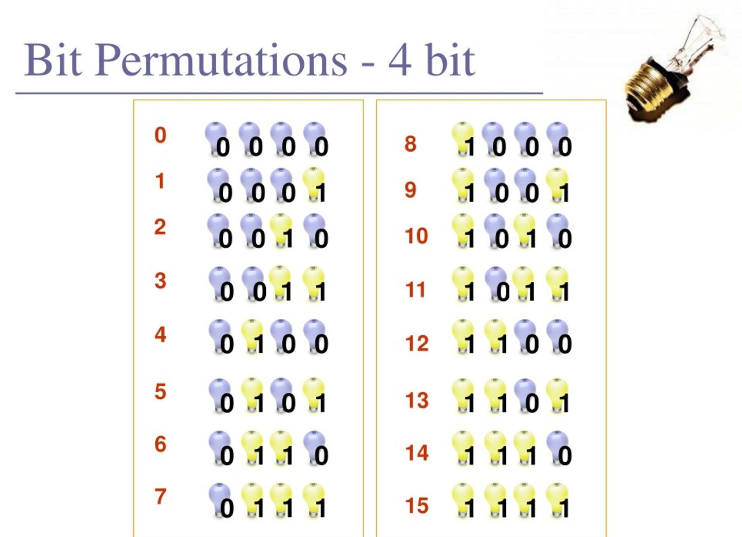

Slide 8
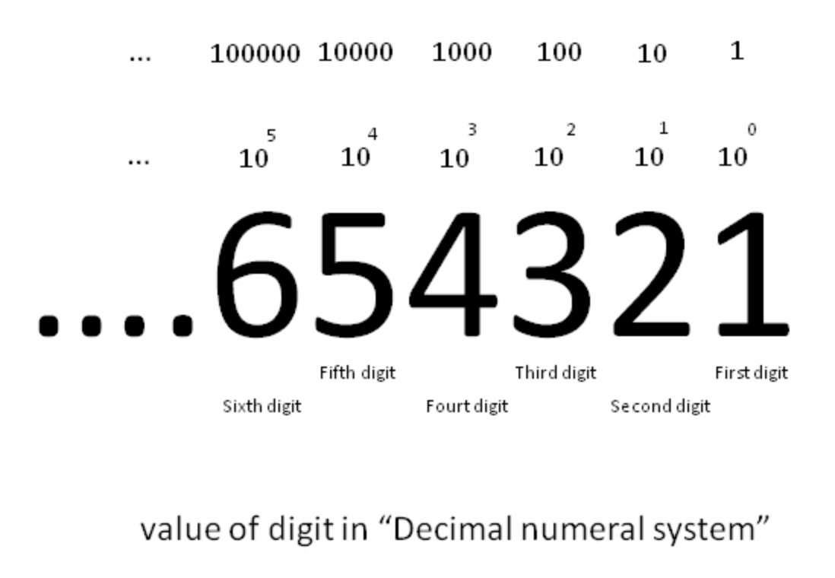
Decimal System (Base 10)
What it is:
The decimal system is what we use in everyday life.
It has 10 digits:
0, 1, 2, 3, 4, 5, 6, 7, 8, 9

Slide 9
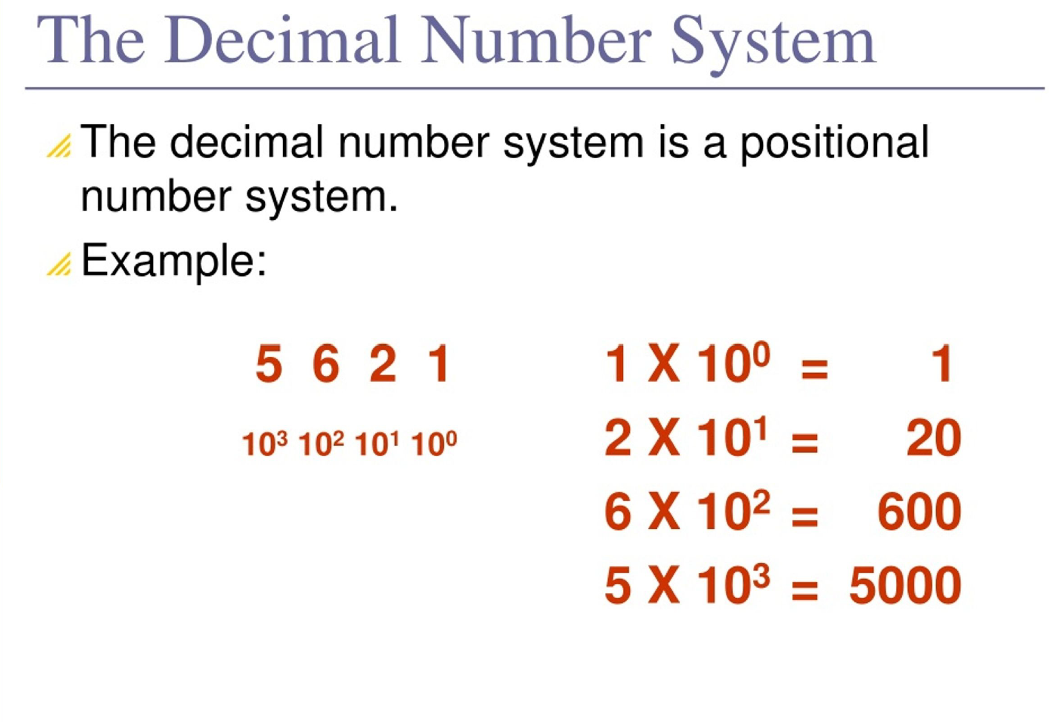

Slide 10
Binary System (Base 2)
What it is:
Used by computers. It has only 2 digits: 0 and 1
Each digit is called a “bit”
Example:
The binary number 1010

Slide 11
Hexadecimal System (Base 16)
What it is:
Used in programming (like color codes, memory addresses).
It has 16 digits:
0-9 and A-F
A = 10
B = 11
C = 12
D = 13
E = 14
F = 15

